Slide 1

Automotive Technology: A Systems Approach, 8e
Chapter 28: Gasoline, Diesel, and Other Fuels
Rob Thompson and Jack Erjavec, Automotive Technology: A Systems Approach, 8th Edition. © 2025 Cengage. All Rights Reserved. May not be scanned, copied or duplicated, or posted to a publicly accessible website, in whole or in part.

Slide 2
Chapter Objectives (1 of 2)
28.01 Describe the uses of crude oil and how it is refined.
28.02 Describe the basic composition of gasoline.
28.03 Explain why materials are added to gasoline to make it more efficient.
28.04 Name the common substances used as oxygenates in gasoline and explain what they do.
28.05 Describe how the quality of a fuel can be tested.

Slide 3
Chapter Objectives (2 of 2)
28.06 Explain the advantages and disadvantages of the various alternative fuels.
28.07 Explain the differences between diesel fuel and gasoline.
28.08 Describe the common types of fuel injection used on today’s diesel engines.
28.09 Describe the various techniques used to allow current diesel engines to meet emission standards.
28.10 Describe how to diagnose diesel fuel system concerns.

Slide 4
Crude Oil
28.01 Describe the uses of crude oil and how it is refined.
Crude oil is also called petroleum, which means oil from the earth.
The oil extracted from the earth is called crude because it has yet to be processed or refined.
Crude oil is commonly referred to as a fossil fuel because it is naturally produced by the decaying of plants and animals that lived a long time ago and were covered by dirt for many years.
Crude oil is a liquid that varies in appearance.
Although the composition of crude oil varies, it typically is:
  84 percent carbon, 14 percent hydrogen, 1 percent to 3 percent sulfur, less than 1 percent nitrogen, less than 1 percent oxygen, less than 1 percent metals, normally nickel, iron, vanadium, copper, and arsenic, and less than 1 percent salts, in the form of sodium chloride, magnesium chloride, and calcium chloride.

Slide 5
Petroleum Products
Most of the petroleum extracted from the earth is processed into hydrocarbon products, such as:
  Asphalt, wax, gasoline, diesel fuel, kerosene jet fuel, heating and other fuel oils, lubricating oils and greases, liquefied petroleum gas, and natural gas.
About 16 percent of the crude oil is processed to make a variety of products, such as polymers, plastics, detergents, deodorants, and medicines.

Slide 6
Hydrocarbons
Hydrocarbons (HCs) in crude oil have many different lengths and structures.
Therefore, the only thing the different hydrocarbons have in common is that they contain carbon and hydrogen.
The number of carbon atoms in an HC molecule defines its length.
Sometimes that number, when combined with the number of hydrogen atoms, is called a chain.
The HC with the shortest chain is methane (CH₄), which is a very light gas.
Longer chains with five or more carbons are liquids or solids.
Asphalt has 35 or more carbon atoms.
HCs contain a great amount of energy, which is why they have been used as a source of energy for many years.

Slide 7
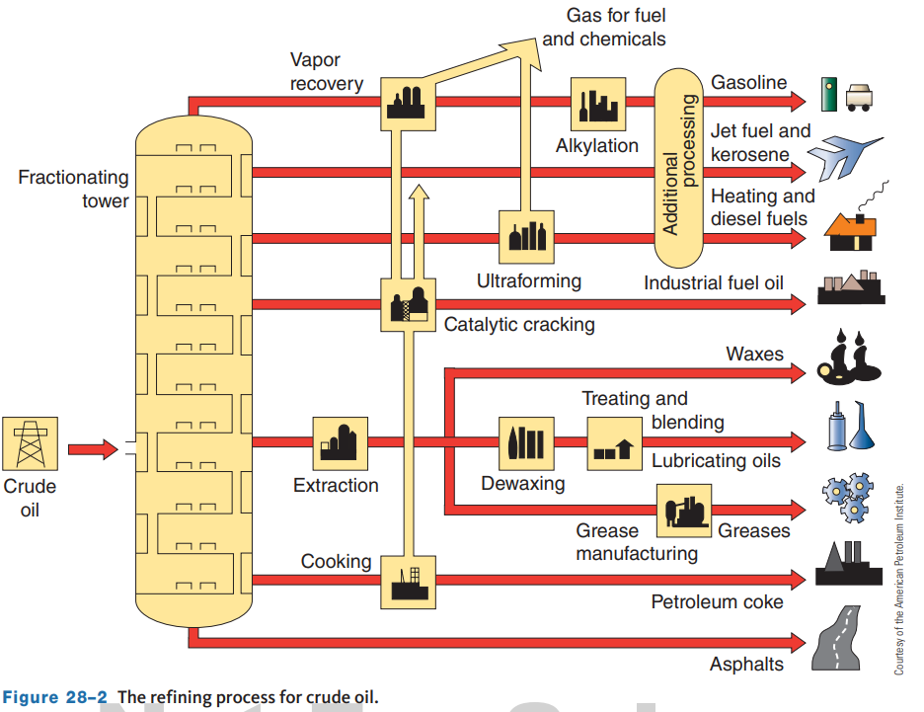
Refining
A refinery is the place where the separation occurs.
The easiest and most common way to separate the various HCs (called fractions) is through a process called fractional distillation.
The basis of this method is simply that the different HC compounds have progressively higher boiling points.
Here are some examples:
  Propane will boil at less than 104 °F (40 °C).
  Gasoline will boil at 104 °F to 401 °F (40 °C to 205 °C).

Slide 8
Gasoline
Gasoline is a complex mixture of approximately 300 various ingredients, mainly HCs.
The chemical symbol for this liquid is C8 H15.
Oil refiners must meet gasoline standards set by the American Society for Testing and Materials (ASTM), the EPA, some state requirements, and their own company standards.
Many additives are blended into gasoline before it is available to the public.
Purpose | Additive
Octane enhancer | Methyl t-butyl ether (MTBE) t-butyl alcohol (TBA) Ethanol Methanol
Antioxidant | Butylated methyl, ethyl and dimethyl phenols Various other phenols and amines
Metal deactivator | Disalicylidene-N-methyldipropylene-triamine N,N'-disalicylidene-1,2-Ethanediamine Other related amines
Ignition controller | Tri-o-cresylphosphate (TOCP)
Icing inhibitor | Isopropyl alcohol
Detergent/dispersant | Various phosphates, amines, phenols, alcohols, and carboxylic acids
Corrosion inhibitor | Carboxylic, phosphoric, and sulfonic acids

Slide 9
Antiknock Quality
An octane number or rating was developed by the petroleum industry so the antiknock quality of a gasoline could be rated.
The octane number is a measure of the fuel’s tendency not to experience detonation in the engine.
The higher the octane rating, the less the engine will have a tendency to knock.
Two methods are used for determining the octane number of gasoline: the motor octane number (MON) method and the research octane number (RON) method.
Both use a laboratory single-cylinder engine equipped with a variable head and knock meter to measure knock intensity.
A test sample of the fuel is used in the engine as the engine’s compression ratio and air–fuel mixture are adjusted to develop specific knock intensity.
There are two primary standard reference fuels: isooctane and heptane.
Isooctane does not knock in an engine but is not used in gasoline because of its expense.
Heptane knocks severely in an engine.

Slide 10
Volatility
Gasoline is very volatile.
It readily evaporates, so it readily mixes with air for combustion.
The volatility of gasoline affects the following performance characteristics or driving conditions:
  Cold Starting and Warm-up, Altitude, and Crankcase Oil Dilution.
There are three methods of measuring the volatility of a fuel.
The most common is the Reid vapor pressure (RVP) test.
  The RVP test is performed by placing a sample of gasoline into a sealed metal container that has a pressure measuring device attached to it.
  The container is submerged in heated (100 °F or 38 °C) water.
  As the fuel is heated, it vaporizes.
  As fuel vaporizes, it creates vapor pressure within the container.
  Vapor pressure is measured in psi.

Slide 11
Basic Gasoline Additives
Anti-Icing or Deicer Isopropyl alcohol
  These are added seasonally to gasoline as an anti-icing agent to prevent fuel line freeze-up in cold weather.
Metal Deactivators and Rust Inhibitors
  These additives are used to inhibit reactions between the fuel and the metals in the fuel system that can form abrasive and filter-plugging substances.
Gum or Oxidation Inhibitors
  Some gasoline contains aromatic amines and phenols to prevent the formation of gum and varnish.
  During storage, harmful gum deposits can form due to the reaction between some gasoline molecules with each other and with oxygen.
Oxidation inhibitors
  These are added to promote gasoline stability.
Detergents
  Detergent additives clean certain critical parts inside the engine.

Slide 12
Oxygenates (1 of 2)
28.04 Name the common substances used as oxygenates in gasoline and explain what they do.
Oxygenates are compounds, such as alcohols and ethers, that contain oxygen.
By carrying oxygen, the fuel tends to lean the mixture.
Oxygenates improve combustion efficiency, thereby reducing emissions.
Many oxygenates also serve as excellent octane enhancers when blended in gasoline.
Oxygenated fuels tend to have lower CO emissions.
It should be noted that the use of oxygenated gasoline may cause a slight decrease in fuel economy in late-model vehicles.
Oxygenates added to gasoline produce what is referred to as reformulated gasoline (RFG).
RFG is also called “cleaner-burning” gasoline and costs slightly more than normal gasoline.
RFG can be used in most engines with no modifications. RFG was formulated to reduce exhaust emissions.

Slide 13
Oxygenates (2 of 2)
Ethanol
  By far the most widely used gasoline oxygenate additive is ethanol (ethyl alcohol).
  Ethanol is a noncorrosive and relatively nontoxic alcohol made from renewable biological sources.
  Ethanol decreases CO emissions due to the higher oxygen content of the fuel.
Methanol
  It is the lightest and simplest of the alcohols and is also known as wood alcohol.
  It is far more corrosive to fuel system components than ethanol, and it is this corrosion that has automakers concerned.
  Methanol is also highly toxic, and there are safety concerns with ingestion, eye or skin contact, and inhalation.
Aromatic Hydrocarbons
  These are petroleum-derived compounds, including benzene, xylene, and toluene, that are being used as octane boosters.

Slide 14
Gasoline Quality Testing
28.05 Describe how the quality of a fuel can be tested.
Two tests can be done to test the quality of gasoline: the Reid vapor pressure test and the alcohol content test.
Testing the RVP of Gasoline
  RVP is a measure of the volatility of gasoline.
  A special fuel vapor pressure tester is needed to test the RVP of gasoline.
  Make sure the gasoline that is being tested is cool.
Alcohol in Fuel Test
  Pump gasoline may contain a small amount of alcohol, normally up to 10 percent.
  If the amount is greater than that, problems may result, such as fuel system corrosion, fuel filter plugging, deterioration of rubber fuel system components, and a lean air–fuel ratio.
  There are many different ways to check the percentage of alcohol in gasoline.
  Some are more exact than others, and some require complex instruments.

Slide 15
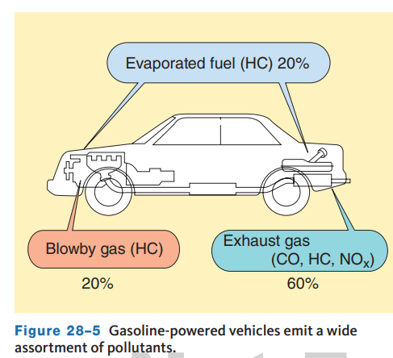
Alternatives to Gasoline
The actual cost of using gasoline in engines is not limited to the price per gallon or liter.
There are other factors, or costs, that need to be considered: our environment, our dependence on foreign oil supplies, and the depletion of future oil supplies.
Any reduction in the use of fossil fuels will have benefits for generations to come.
Here are a few simple facts:
  There are well over 280 million registered vehicles on the road as of 2021 in the United States.
Automobiles and gasoline contribute to environmental damage.
  Automobiles emit pollutants.

Slide 16
Alternative Fuels
The concerns of burning fossil fuels and the decline of their reserves have led to a comprehensive search for alternative fuels.
While looking at the viability of an alternative fuel, many things are considered, including emissions, cost, availability, energy density, safety, engine life, fueling facilities, weight and space requirements for fuel tanks, and the operating range of a fully fueled vehicle.
By using alternative fuels, we not only can reduce our reliance on petroleum, but we can reduce emissions and the effects an automobile’s exhaust has on global warming.
Many of these fuels are also being considered as the fuel of choice for fuel cell electric vehicles.
Much attention has been paid to renewable fuel sources.
Renewable fuels are those derived from nonfossil sources and produced from plant or animal products or wastes (biomass).

Slide 17
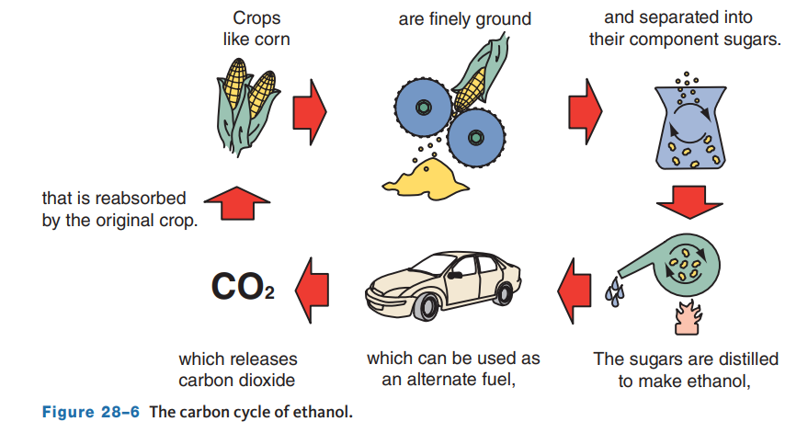
Ethanol
Ethanol is a high-quality, low-cost, high-octane fuel (rated at 115) that burns cleaner than gasoline.
Ford’s Model T was designed to run on ethyl alcohol (ethanol).
Ethanol (CH₃CH₂OH), commonly called grain alcohol, is a renewable fuel made from nearly anything that contains carbon.
Ethanol can be used as a high-octane fuel in vehicles and is often mixed with gasoline to boost its octane rating.
For automotive use, ethanol is blended with gasoline.
The common blends are an E10 blend, E15, and E85.

Slide 18
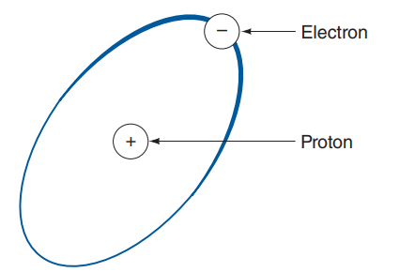
Hydrogen
Hydrogen is cited by some as the fuel of the future because it is full of energy due to its atomic structure and abundance.
It is the simplest and lightest of all elements and has one proton and one electron.
Hydrogen is a colorless and odorless gas.
Hydrogen is commonly extracted from water, fossil fuels, coal, and biomass.
The two most common ways that hydrogen is produced are steam reforming and electrolysis.
Currently, it costs much more to produce hydrogen than it does to produce other fuels such as gasoline.

Slide 19
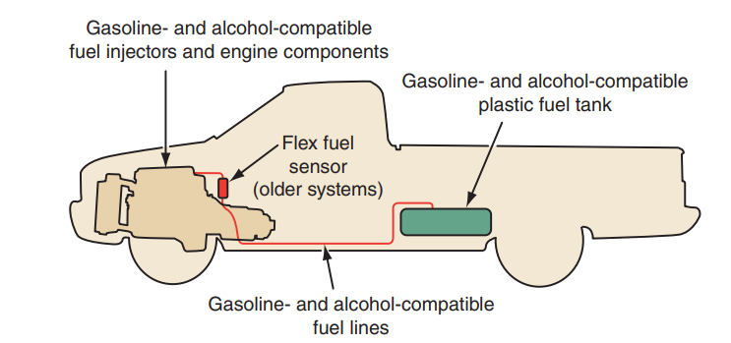
Flex Fuel Vehicles
Flexible fuel vehicles (FFV) can run on ethanol or gasoline, or a mixture of the two.
The alcohol fuel and gasoline are stored in the same tank.
This gives the driver flexibility and convenience when refilling the fuel tank.
Many vehicles are fitted with systems that allow the use of multiple fuels.
These include vehicles from Chrysler, Ford Motor Co., General Motors, and Nissan.
Flex fuel vehicles may have a clover leaf symbol (internally or externally) that shows they can use multiple fuels.

Slide 20
Knowledge Check (1 of 2)
What is the definition of a renewable fuel?

Slide 21
Knowledge Check Answer (1 of 2)
  Answer: Renewable fuels are those derived from nonfossil sources and produced from plant or animal products or wastes (biomass).

Slide 22
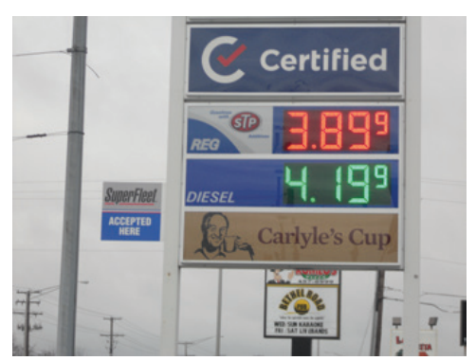
Diesel Fuel (1 of 3)
28.07 Explain the differences between diesel fuel and gasoline.
Diesel fuel is designed to be used by diesel engines and is therefore not an alternative fuel for gasoline engines.
Diesel fuel is a fossil fuel, but it has different properties and characteristics than gasoline.
Diesel fuel also evaporates much more slowly than gasoline—its boiling point is actually higher than the boiling point of water.
The downside of diesel fuel is that it costs more per gallon than gasoline.
Diesel fuel is used to power a wide variety of vehicles and other equipment.

Slide 23
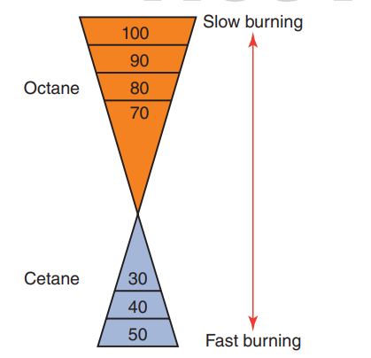
Diesel Fuel (2 of 3)
Cetane Ratings
  Diesel fuel should ignite almost instantaneously when it is injected into a cylinder.
  The fuel’s ignition quality is expressed by a cetane rating (CN).
  The cetane rating of diesel fuel is a measure of the ease with which the fuel can be ignited.
  Because diesel fuel ignites with compression instead of a spark, it is most efficient when it ignites as quickly as possible.
  The cetane rating of the fuel is based on a test that uses a single-cylinder test engine with a variable compression ratio.

Slide 24
Diesel Fuel (3 of 3)
Biodiesel Fuels
  Biodiesel is an alternative fuel for diesel engines.
  Biodiesel fuel is not made from petroleum, rather it is made from renewable biological sources.
  Most commercially available biodiesel fuel is made from soybean oil.
  However, it is also produced from animal fats, recycled cooking oil, canola oil, corn, and sunflowers.
  Biodiesel is considered a renewable fuel.
  Biodiesel can be used in diesel engines with little or no modifications to the engine.
  Pure biodiesel is biodegradable, nontoxic, and free of sulfur and aromatics.
  It can be used by itself or blended with petroleum-based diesel fuel.
  The two most common blends are B5, which is 95 percent petroleum-based fuel and 5 percent biodiesel fuel, and B20, which contains 20 percent biodiesel blended into regular diesel fuel.

Slide 25
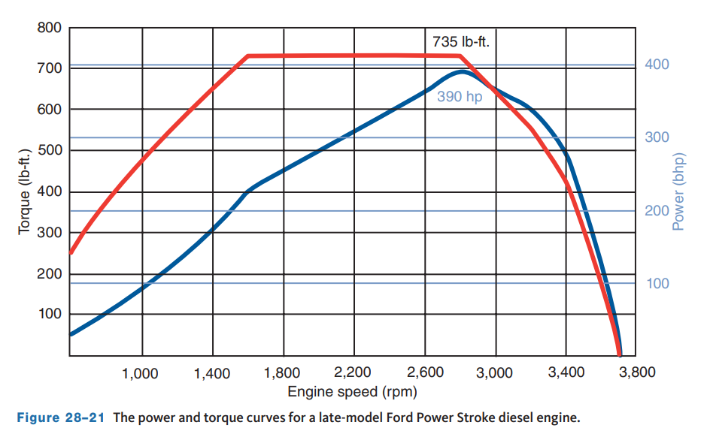
Diesel Engines
Diesel engine use in cars and SUVs is not as common as in light duty trucks.
One advantage diesel-powered cars have over gasoline vehicles is increased fuel economy.
This advantage often disappears when compared to a hybrid vehicle.
Diesel engines provide more torque than a gasoline engine of the same size and consume less fuel per mile, making them popular in light duty trucks.
The fuel injected into a diesel engine is ignited by the heat of compression.
A diesel engine needs a compression ratio of at least 16:1.

Slide 26
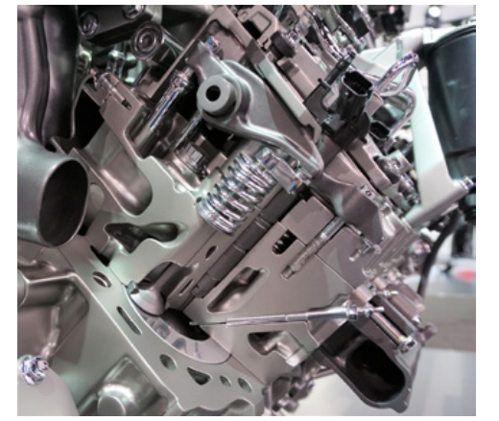
Diesel Fuel Injection
28.08 Describe the common types of fuel injection used on today’s diesel engines.
Most of today’s diesel engines use direct fuel injection, in which fuel is injected directly into the cylinder.
In an indirect injection (IDI) diesel engine, fuel is injected into a small prechamber, which is connected to the combustion chamber by a small opening.
Many IDI systems were mechanically operated and the fuel pump not only supplied fuel system pressure, but also controlled the timing of the injectors.
With direct injection (DI), the pistons have a depression where initial combustion takes place.

Slide 27
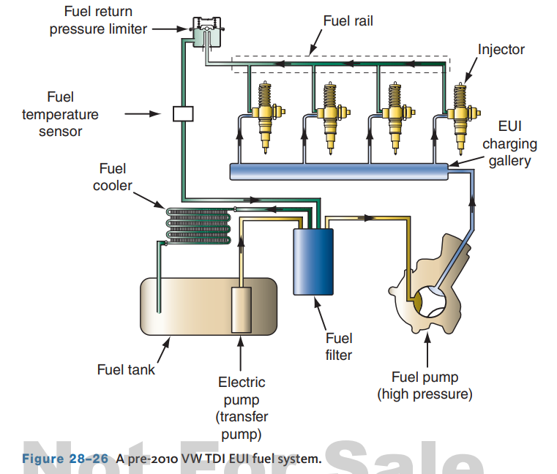
Electronic Unit Injection (EUI)
Electronic unit injector (EUI) systems have been used since the 1980s but primarily in heavy-duty trucks.
Volkswagen used EUIs in their TDI engines until 2010.
In these systems, the injector’s pressure is the result of a camshaft-driven high-pressure pump.
However, the engine’s PCM controls the amount of fuel sprayed into the cylinders and the timing of the spray.
Although effective, EUIs did not allow for the precise control of injection needed to meet today’s driving needs and emission standards.

Slide 28
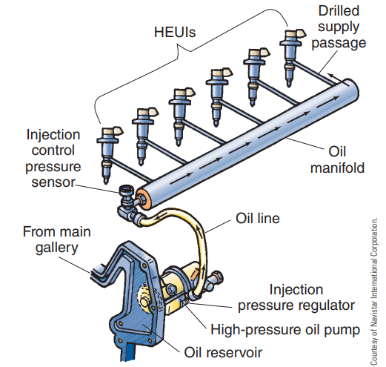
Hydraulic Electronic Unit Injection (HEUI)
Hydraulic Electronic Unit Injection (HEUI) relies on engine oil pressure to control the operation of the individual injectors.
The engine oil opens the injector by pressing down on a diaphragm inside each injector.
In turn, the diaphragm pushes on the fuel inside the injector and pressurizes it from 3,000 to 21,000 psi.
Fuel under that pressure is directly injected into the cylinders.
Since the injectors in this system pressurize the fuel for delivery into the cylinders, there is no need for an expensive and difficult to control high-pressure fuel pump.

Slide 29
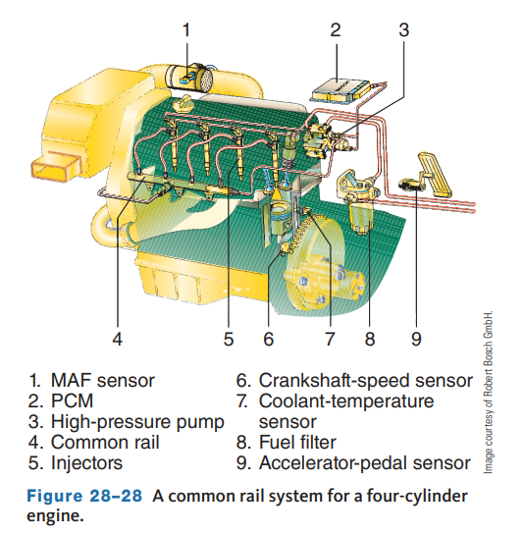
Common Rail Injection
A common rail (CR) fuel system is one that has a fuel rail that carries high-pressure fuel to the individual injectors.
Since the injectors are electronically controlled, the pressurized fuel is immediately available at each injector.
Each electrohydraulic injector (EHI) is switched open and closed by the PCM.
Each fuel injector is positioned directly above the piston and is connected to the fuel rail by steel lines.
Since 2010, nearly all “on the highway” diesel engines use CR fuel injection systems.
The use of CR allows the engines to meet diesel emissions standards and fuel economy expectations. They also provide for: ● Lower engine noise levels ● Balanced engine cylinder pressures ● High injection pressures independent of engine speed ● The injectors can be switched on and off at high speeds and allow for as many as seven injection ‘‘events’’ during a single power stroke.

Slide 30
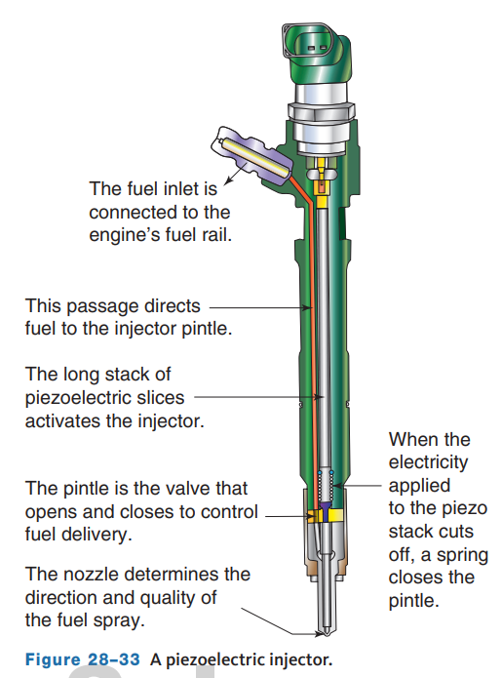
Piezoelectric Injectors
Piezoelectric injectors operate in much the same way as solenoid injectors, except they do not rely on an electrical winding or coil.
The injectors have no moving parts.
Rather a piezo injector relies on many, very thin layers of piezoelectric crystal material stacked on each other at the orifice of the injector’s nozzle.
When electricity is applied to the stack, it expands slightly (approximately 0.004 inches).
The expansion, however, is enough to allow fuel to spray out of the nozzle.
When no electricity is applied to the stack, fuel cannot leave the nozzle because the piezo layers are tightly jammed against each other and the pintle closes by the force of a return spring.

Slide 31
Discussion
Diesel fuel injection systems have changed a lot over the years coming from IDI and currently common rail with piezoelectric injectors.
Have a class discussion about what changes have occurred and why you suspect they have occurred. What is the driving force?

Slide 32
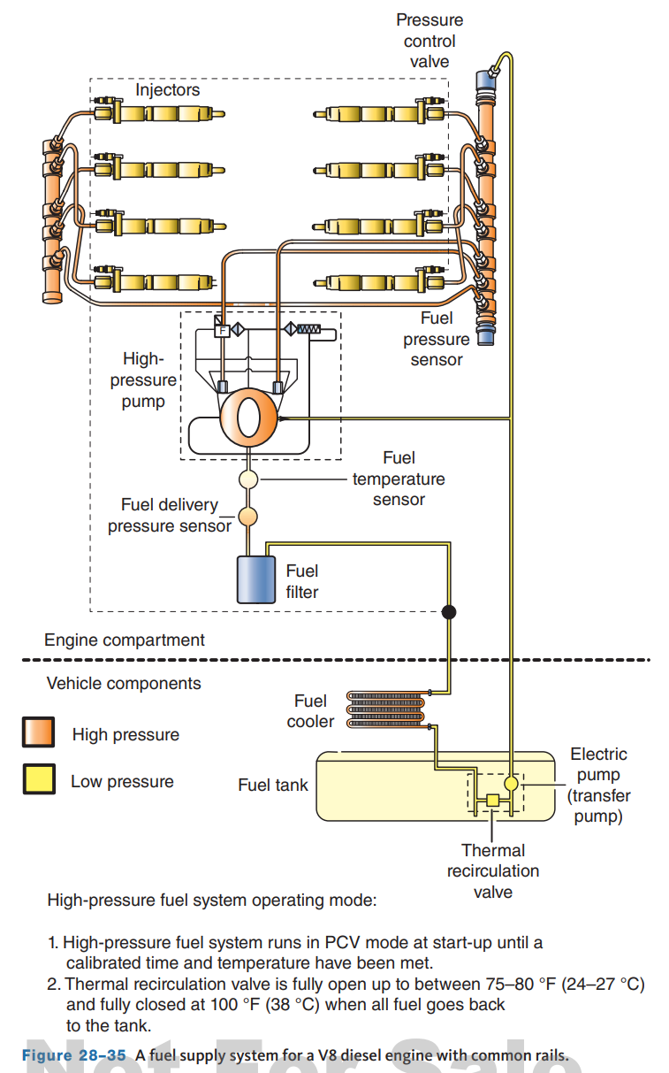
Fuel Delivery
The fuel tank for a diesel engine has a larger filler neck than those found on gasoline vehicles.
This is one reason some consumers make the mistake of putting gasoline in their diesel tank.
Also since diesel fuel is not as volatile as gasoline; the fuel tank is not fitted with evaporative emission control devices.
The fuel in the tank is drawn out by an in-tank transfer pump.
This pump is normally an electrically driven, low-pressure, high-volume pump.
The pump may run continuously or cycled by the PCM.
The purpose of the pump is to supply fuel to the injection pump.

Slide 33
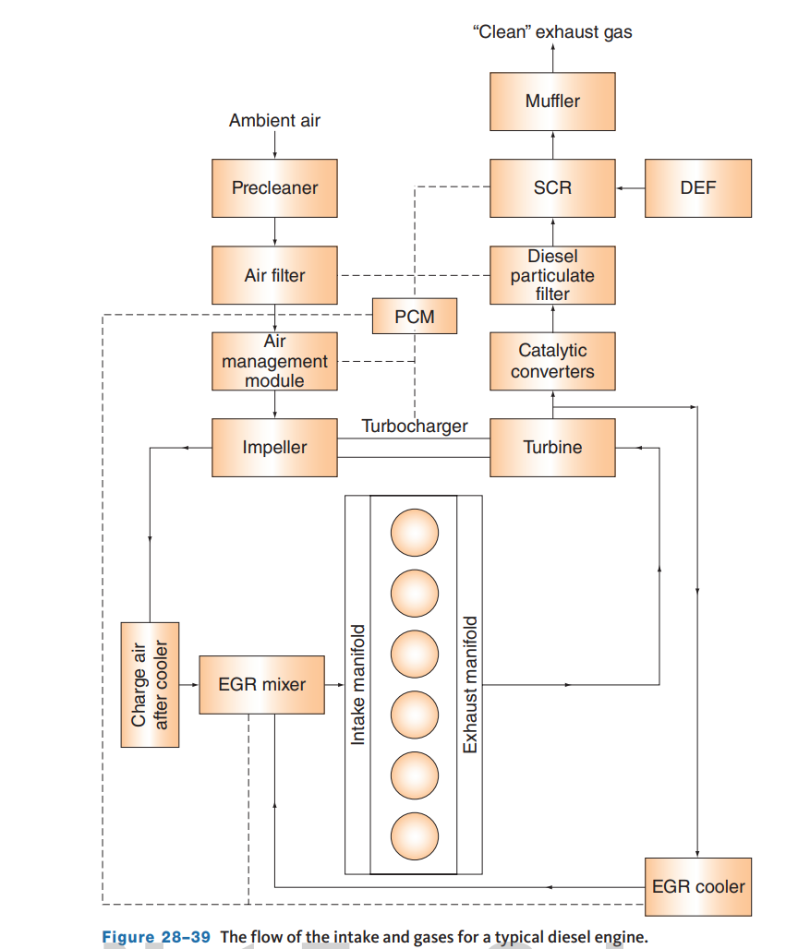
Diesel Emission Controls
28.09 Describe the various techniques used to allow current diesel engines to meet emission standards.
With new technologies (such as CR systems) and cleaner fuels, their emissions levels can be comparable to the best of gasoline engines.
Today’s diesel engines must meet the same emissions standards as a gasoline engine.
Diesel engines naturally emit high amounts of (PM) particulate matter (soot) and NOx emissions.
To decrease these emissions, many new diesel vehicles have an assortment of catalysts and an EGR system to clean the exhaust before it leaves the tailpipe; others use Selective Catalytic Reduction (SCR) systems.

Slide 34
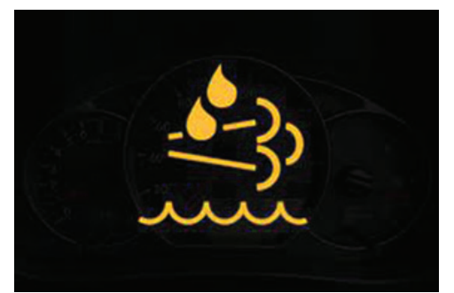
Diesel Exhaust Particulate Filter
The DPF needs to be periodically purged of particulates; known as regeneration.
To do this, the PCM allows a measured amount of raw fuel to enter the filter which causes the temperature to increase.
The heat then burns the trapped soot and the filter is regenerated.
There are three types of regeneration (regen): passive, active, and manual.
Passive regeneration takes place under normal operating conditions.
Active regeneration occurs when the pressure sensors determine the DPF is restricted to the point of needing cleaned.
A REGEN light will often illuminate on the instrument panel when this takes place.

Slide 35
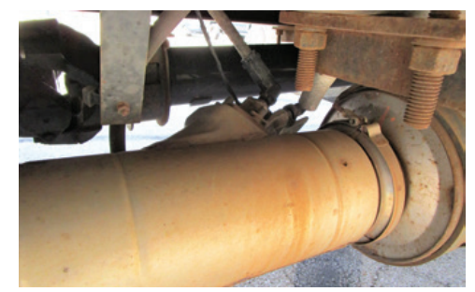
Selective Catalytic Reduction Systems
The selective catalytic reduction (SCR) unit fits in the exhaust between the DOC and DPF.
It reduces NOx emissions when a reductant is injected over the SCR catalyst.
The use of an SCR breaks down NOx into water vapor and nitrogen (N2), thereby reducing the amount of EGR needed to greatly decrease NOx .
In some cases, an SCR equipped engine does not need an EGR valve to meet emission standards.
A reductant, also called a reducing agent, is a material that donates an electron to another material during the redox process.
The common reductants used in SCR systems are ammonia and urea water solutions.

Slide 36
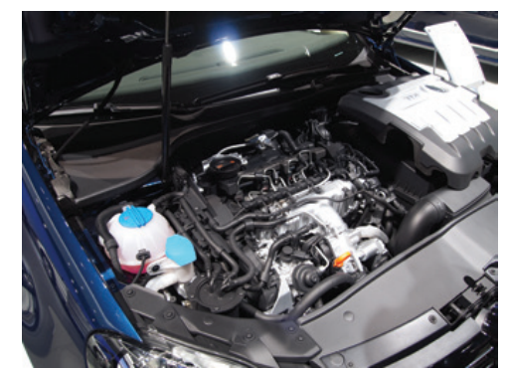
TDI Engines
Perhaps, the most common “clean” diesels are the TDI engines made by Audi and Volkswagen.
There are other manufacturers, but Audi and VW seem to be the current dominant ones in North America.
Both manufacturers (although they really are from the same corporation) use the same technologies.
TDI (Turbocharged Direct Injection) is a design of diesel engines, which features turbocharging and direct fuel injection.

Slide 37
Diagnostics
28.10 Describe how to diagnose diesel fuel system concerns.
In most cases, diesel engines can be diagnosed with a scan tool, as outputs; therefore, the data a scan tool retrieves is similar for both types of engines.
The scan tool will also display the DTCs recorded by the system.
Diagnostics for diesel control systems vary with the manufacturer.
These checks are universal regardless of the manufacturer:
  Action of the solenoid and injectors
  The injection actuation pressure
  Active faults in the system
  Previous faults held in memory
Common faults include hard starting, no-start, extended cranking before starting, and low power.
Using a scan tool, check the sensor values to help pin down the source of the problem.

Slide 38
Diesel Exhaust Smoke Diagnosis
Although some exhaust smoke is considered normal operation for most diesel engines, especially older ones, the cause of high emissions, visible emissions, and excessive smoke should be diagnosed and repaired.
Basically, the exhaust emissions from a diesel engine can be described as a gas, liquid, or solid.
  Gaseous Emissions
    From the outside, a gaseous emission cannot be seen. However, it may contain many different undesirable elements, such as NOx , CO, and HC.
  Liquid Emissions
    Again, according to the eye, liquid emissions may only appear as a white to gray smoke. Gray or blue smoke is normally due to oil burning caused by worn piston rings, scored cylinder walls, or bad valve stem seals.
  Solid Emissions
    Normally, solid emissions appear as black soot, which is caused by incomplete combustion due to a lack of air or a fault in the injection system.

Slide 39
Cylinder Balance Test
One way to conduct a cylinder balance test on early (non-computer-controlled) diesel engines is to measure the resistance of the glow plugs after the engine has run for a while.
Remember that the heating element of the glow plugs increases in resistance as their temperature increases.
Therefore, all glow plugs should have about the same amount of resistance when checked with an ohmmeter before the engine has been started and after the engine has been started and ran.
By looking at the resistance of the glow plugs, you may be able to identify a weak cylinder.

Slide 40
Knowledge Check (2 of 2)
A vehicle that is emitting blue/gray smoke would indicate what condition?

Slide 41
Knowledge Check Answer (2 of 2)
Gray or blue smoke is normally due to oil burning caused by worn piston rings, scored cylinder walls, or bad valve stem seals.

Slide 42
Chapter Reflection
Please take a moment to compare your understanding of gasoline, diesel, and other fuels. Then respond to the following questions in one or two paragraphs. Use 150–200 words in your reflection.
Was there any difficult to understand concepts in this chapter? What will you do to gain a better understanding of these concepts?
Considering all you have learned, do you feel you are prepared to perform basic diagnosis of the fuel systems as described in this chapter? How can you become more prepared?

